Slide 1



UNIT 2
Look back 2
Part 1

Slide 2
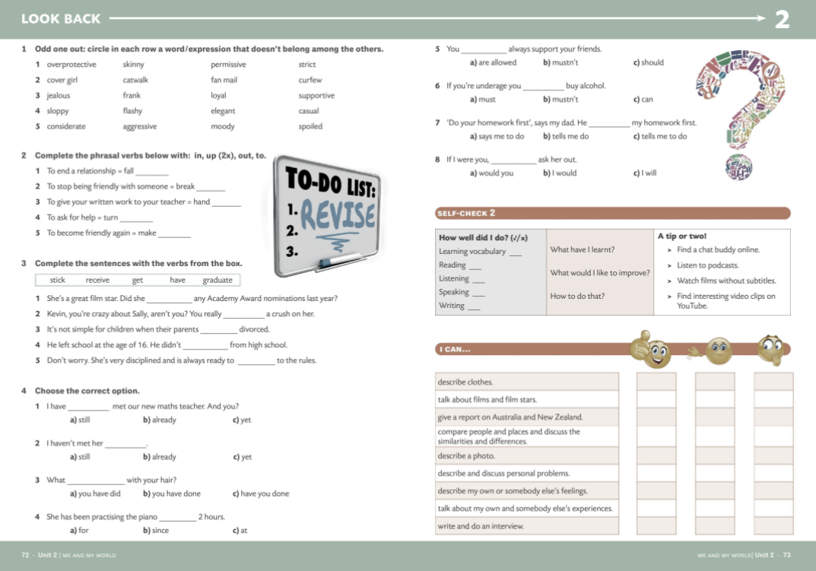
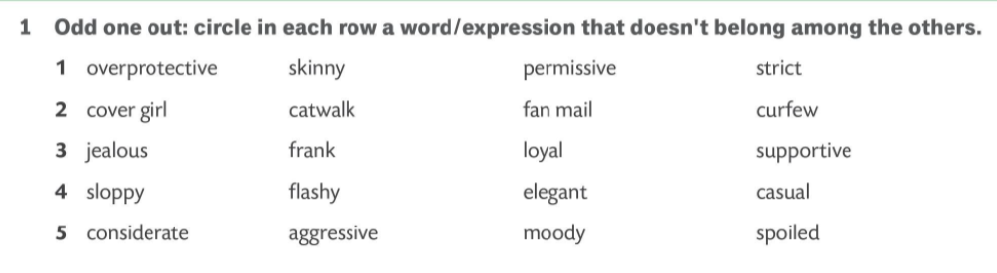
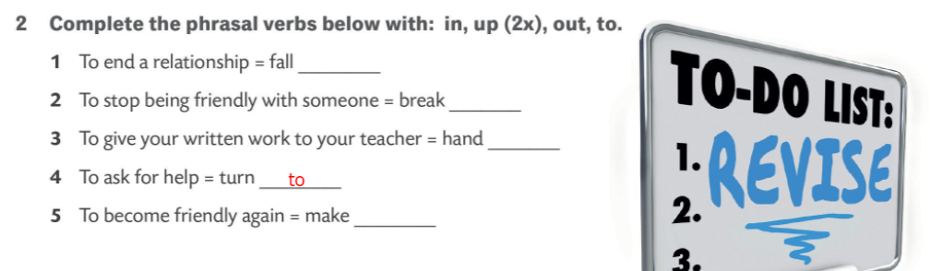
out
up
in
up

Slide 3
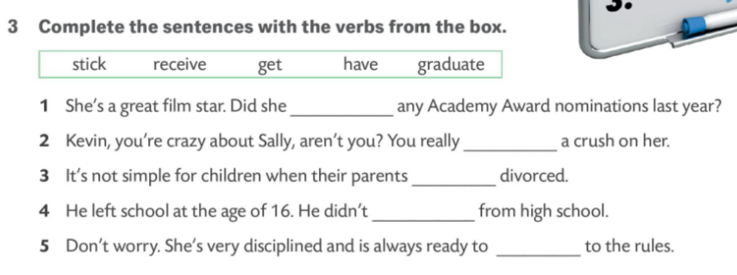

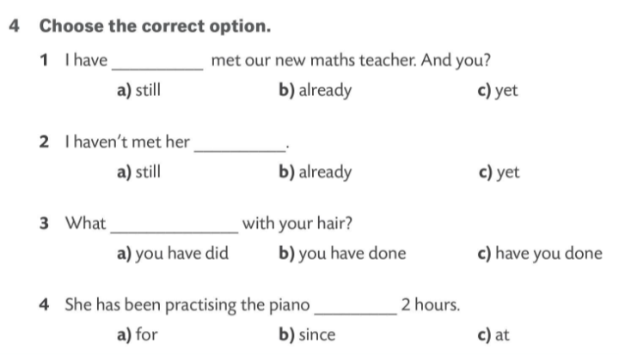
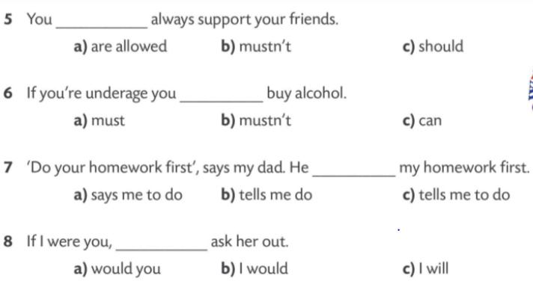
receive
have
get
graduate
stick

Slide 4
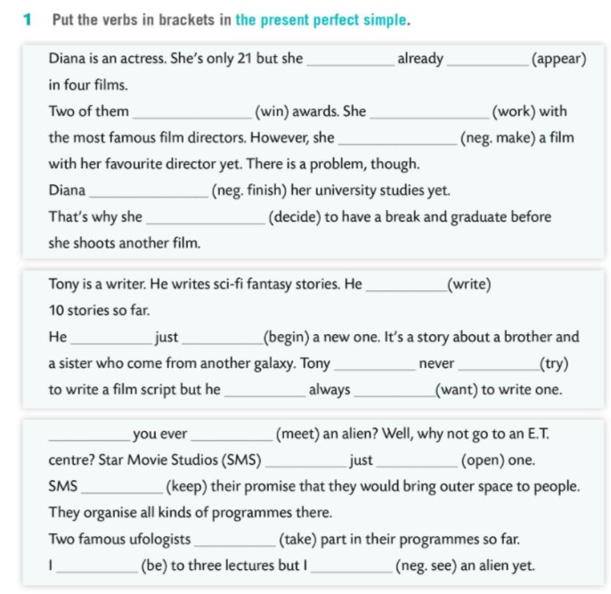
has
appeared
have won
has worked
hasn’t made
hasn’t finished
has decided
has written
has
begun
has
tried
has
wanted
Have
met
have
opened
have kept
have taken
have been
haven’t seen

Slide 5
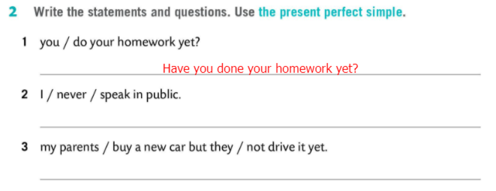
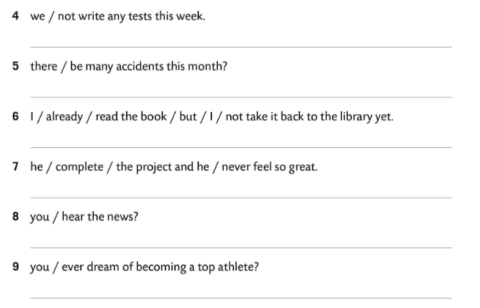
I have never spoken in public.
My parents have bought a new car but they haven’t driven it yet.
We haven’t written any tests this week.
Have there been any accidents this month?
I have already read the book but I haven’t taken it back to the library yet.
He has completed the project and he has never felt so great.
Have you heard the news?
Have you dreamt of becoming a top athlete?

Slide 6
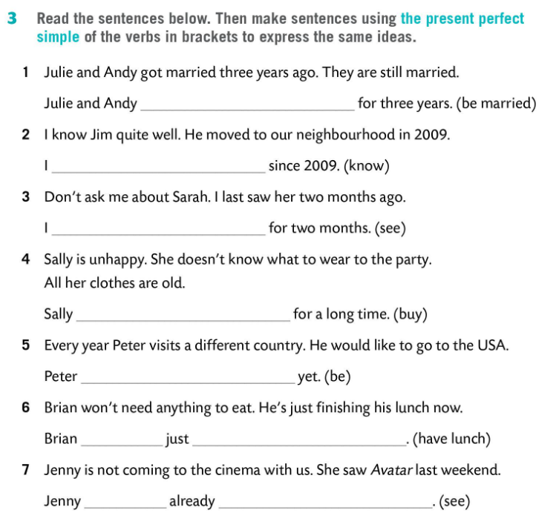
have been married
have known him
haven’t seen Sarah
hasn’t bought
has not been
has
had lunch
has
seen Avatar

Slide 7
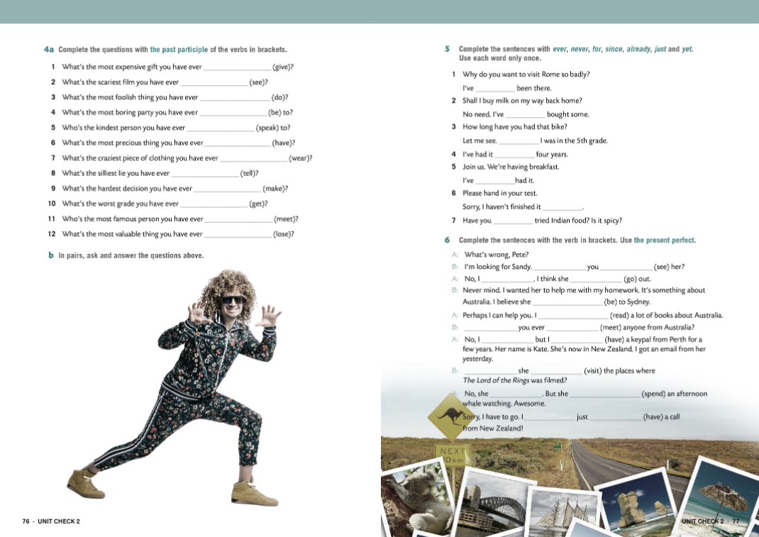
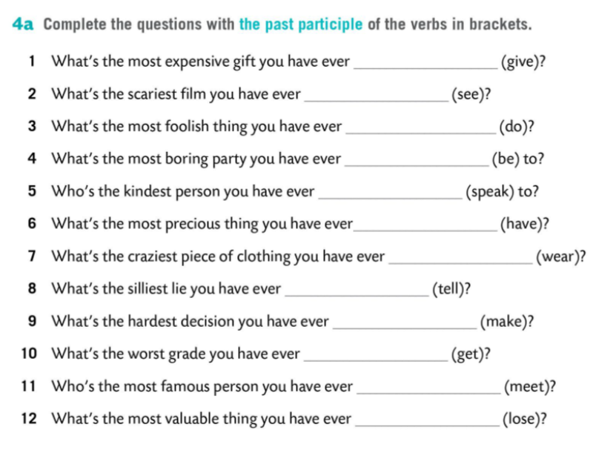

given
seen
done
been
spoken
had
worn
told
made
got
met
lost

Slide 8
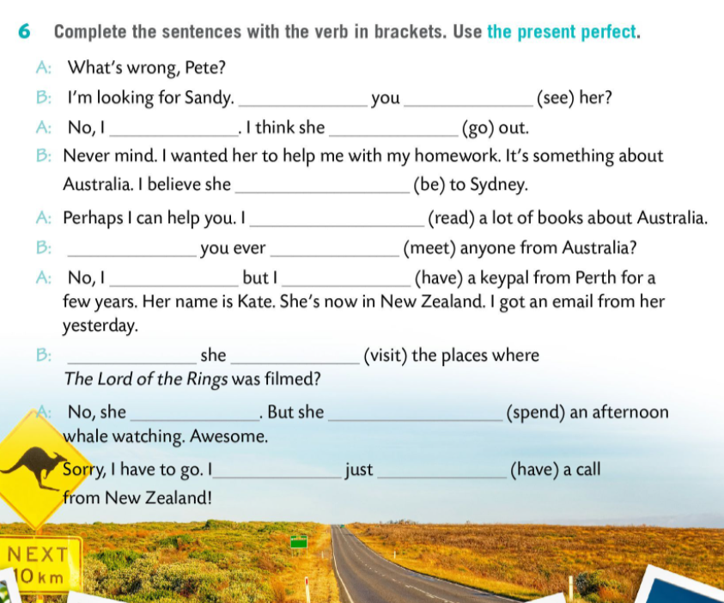
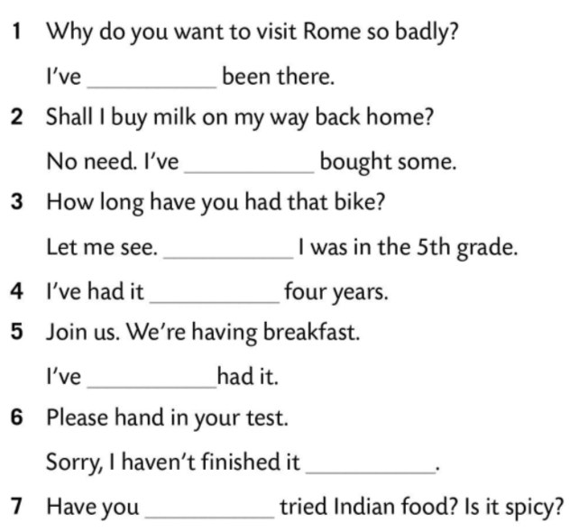
Have
seen
haven’t
has gone
never
has been
have read
already
Have
met
haven’t
have had
Since
for
Has
visited
just
hasn’t
has spent
have
had
yet
ever

Slide 9
